Slide 1
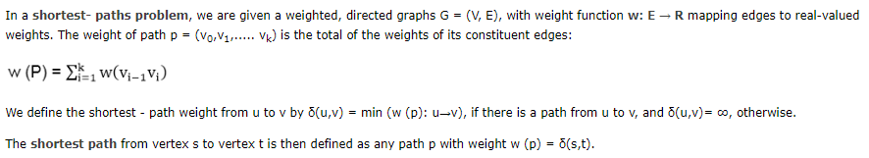
Shortest path algorithms

Slide 2
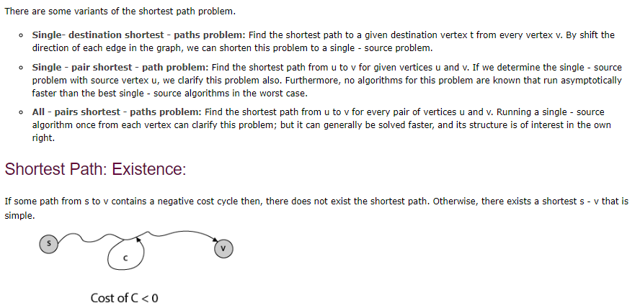
Variants

Slide 3
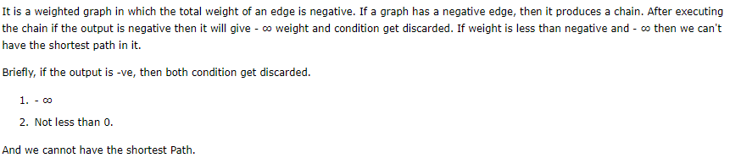
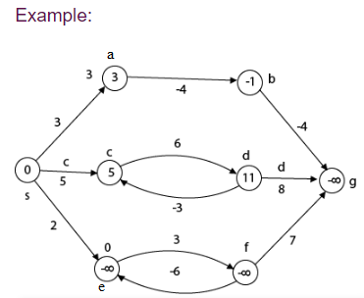
Negative weights

Slide 4
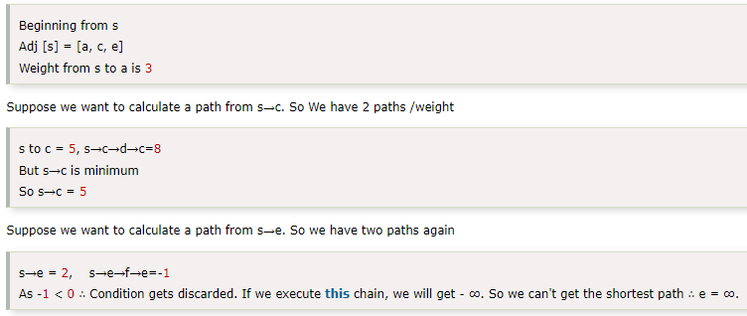
Example Cont…

Slide 5
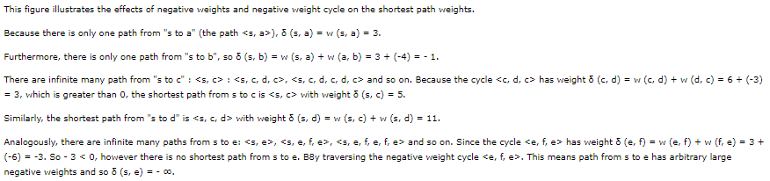

Slide 6
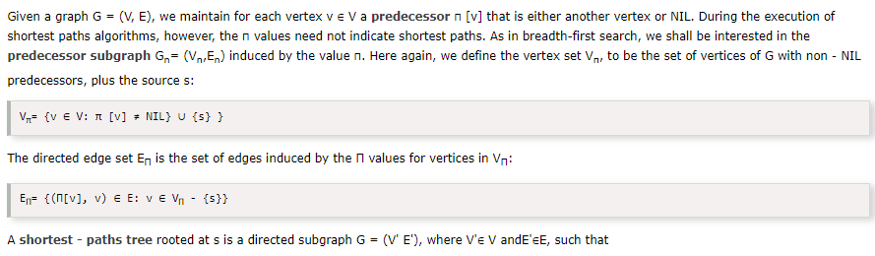

Representing: Shortest Path

Slide 7
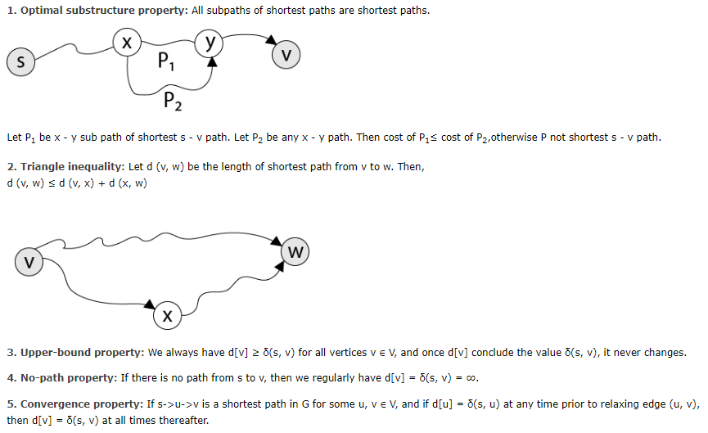
Properties of shortest path

Slide 8
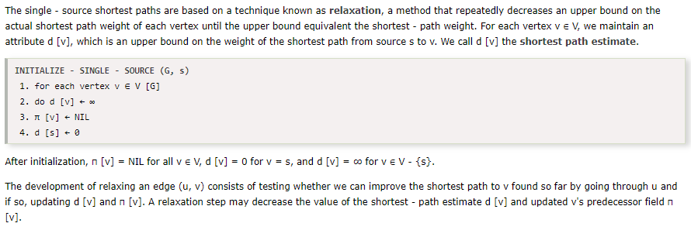
Relaxation

Slide 9
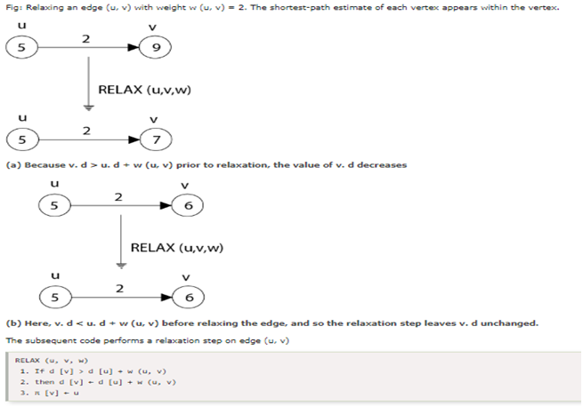

Slide 10
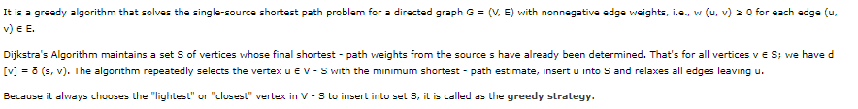
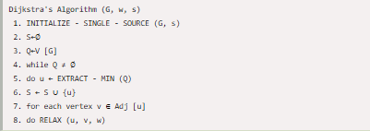
Dijkstra’s algorithm

Slide 11
Algorithm cont…
Dijkstra's algorithm solves the single-source shortest-path problem when all edges have nonnegative weights. It is a greedy algorithm and similar to Prim's algorithm. Algorithm starts at the source vertex, s, it grows a tree, T, that ultimately spans all vertices reachable from S. Vertices are added to T in order of distance i.e., first S, then the vertex closest to S, then the next closest, and so on. The Following implementation assumes that graph G is represented by adjacency lists

Slide 12
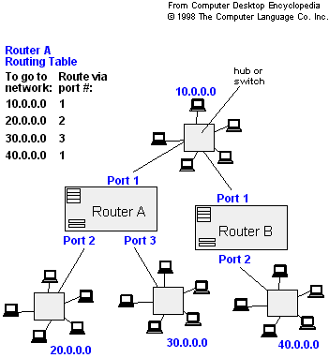
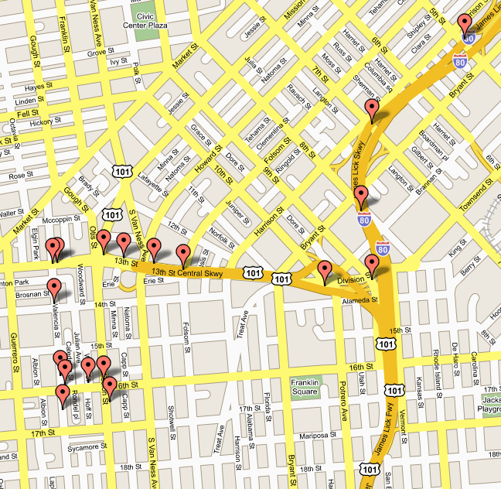
Applications
- Maps (Map Quest, Google Maps)
- Routing Systems

Slide 13
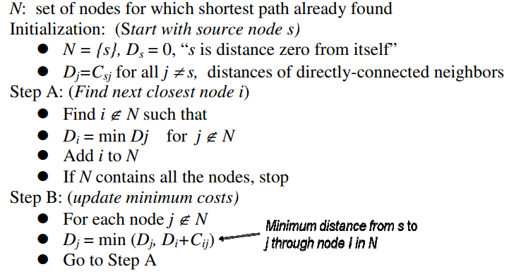

Slide 14
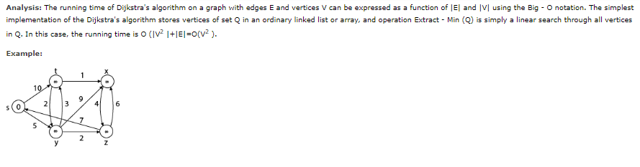

Slide 15
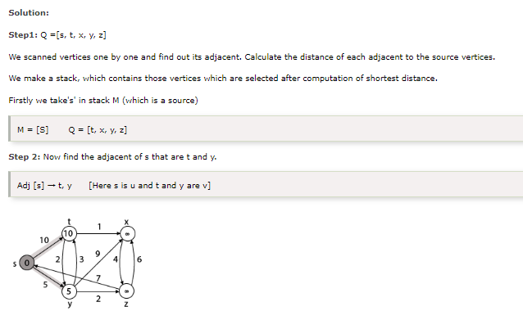

Slide 16
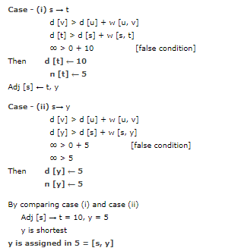
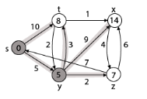

Slide 17
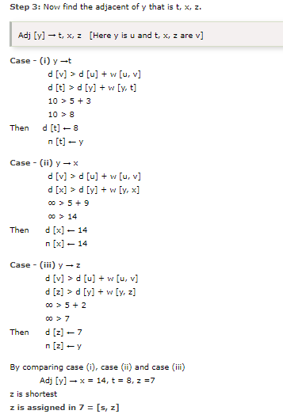
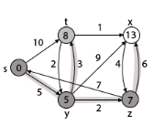

Slide 18
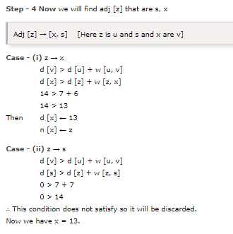
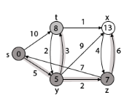

Slide 19
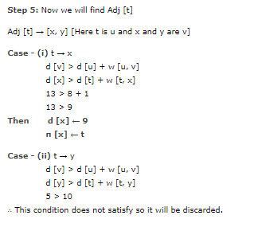
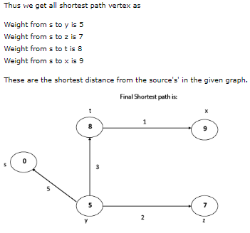
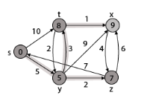

Slide 20
Disadvantage of Dijkstra's Algorithm:
It does a blind search, so wastes a lot of time while processing.
It can't handle negative edges.
It leads to the acyclic graph and most often cannot obtain the right shortest path.
We need to keep track of vertices that have been visited.

Slide 21
Bellman-Ford Algorithm
Solves single shortest path problem in which edge weight may be negative but no negative cycle exists.
This algorithm works correctly when some of the edges of the directed graph G may have negative weight. When there are no cycles of negative weight, then we can find out the shortest path between source and destination.
It is slower than Dijkstra's Algorithm but more versatile, as it capable of handling some of the negative weight edges.
This algorithm detects the negative cycle in a graph and reports their existence.
Based on the "Principle of Relaxation" in which more accurate values gradually recovered an approximation to the proper distance by until eventually reaching the optimum solution.
Given a weighted directed graph G = (V, E) with source s and weight function w: E → R, the Bellman-Ford algorithm returns a Boolean value indicating whether or not there is a negative weight cycle that is attainable from the source. If there is such a cycle, the algorithm produces the shortest paths and their weights. The algorithm returns TRUE if and only if a graph contains no negative - weight cycles that are reachable from the source.

Slide 22
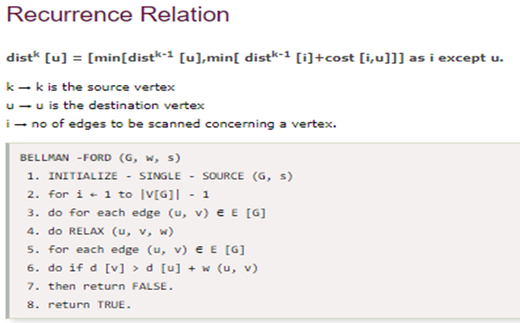


Slide 23
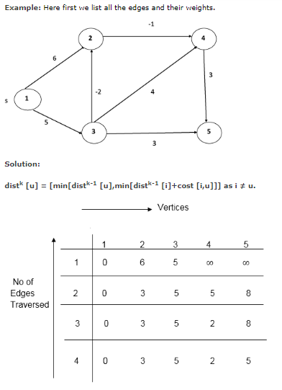

Slide 24
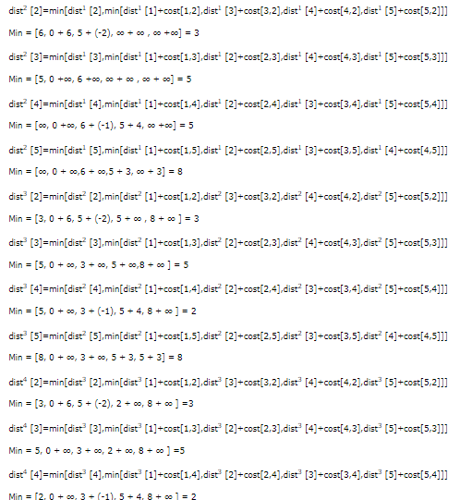
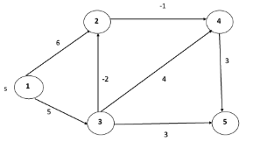

Slide 25
Floyd-Warshall Algorithm
Let the vertices of G be V = {1, 2........n} and consider a subset {1, 2........k} of vertices for some k. For any pair of vertices i, j ∈ V, considered all paths from i to j whose intermediate vertices are all drawn from {1, 2.......k}, and let p be a minimum
weight path from amongst them. The Floyd-Warshall algorithm exploits a link between path p and shortest paths from i to j with all intermediate vertices in the set {1, 2.......k-1}. The link depends on whether or not k is an intermediate vertex of path p.
If k is not an intermediate vertex of path p, then all intermediate vertices of path p are in the set {1, 2........k-1}. Thus, the shortest path from vertex i to vertex j with all intermediate vertices in the set {1, 2.......k-1} is also the shortest path i to j with all intermediate vertices in the set {1, 2.......k}.
If k is an intermediate vertex of path p, then we break p down into i → k → j.

Slide 26
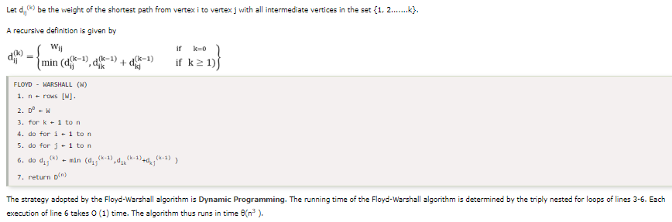

Slide 27
Johnson's Algorithm
The problem is to find the shortest path between every pair of vertices in a given weighted directed graph and weight may be negative. Using Johnson's Algorithm, we can find all pairs shortest path in O (V² log ? V+VE ) time. Johnson's Algorithm uses both Dijkstra's Algorithm and Bellman-Ford Algorithm.
Johnson's Algorithm uses the technique of "reweighting." If all edge weights w in a graph G = (V, E) are nonnegative, we can find the shortest paths between all pairs of vertices by running Dijkstra's Algorithm once from each vertex. If G has negative - weight edges, we compute a new - set of non - negative edge weights that allows us to use the same method. The new set of edges weight w must satisfy two essential properties:
For all pair of vertices u, v ∈ V, the shortest path from u to v using weight function w is also the shortest path from u to v using weight function w.
For all edges (u, v), the new weight w (u, v) is nonnegative.
Given a weighted, directed graph G = (V, E) with weight function w: E→R and let h: v→R be any function mapping vertices to a real number.

Slide 28
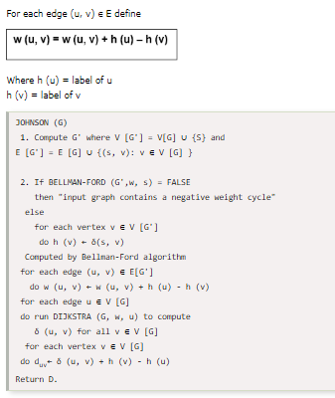

Slide 29
Complexity theory
Definition of NP class Problem: - The set of all decision-based problems came into the division of NP Problems who can't be solved or produced an output within polynomial time but verified in the polynomial time. NP class contains P class as a subset. NP problems being hard to solve.
Definition of P class Problem: - The set of decision-based problems come into the division of P Problems who can be solved or produced an output within polynomial time. P problems being easy to solve
Definition of Polynomial time: - If we produce an output according to the given input within a specific amount of time such as within a minute, hours. This is known as Polynomial time.

Slide 30
Definition of Non-Polynomial time: - If we produce an output according to the given input but there are no time constraints is known as Non-Polynomial time. But yes output will produce but time is not fixed yet.
Definition of Decision Based Problem: - A problem is called a decision problem if its output is a simple "yes" or "no" (or you may need this of this as true/false, 0/1, accept/reject.) We will phrase many optimization problems as decision problems. For example, Greedy method, D.P., given a graph G= (V, E) if there exists any Hamiltonian cycle.
Definition of NP-hard class: - Here you to satisfy the following points to come into the division of NP-hard
If we can solve this problem in polynomial time, then we can solve all NP problems in polynomial time
If you convert the issue into one form to another form within the polynomial time
Definition of NP-complete class: - A problem is in NP-complete, if
It is in NP
It is NP-hard

Slide 31
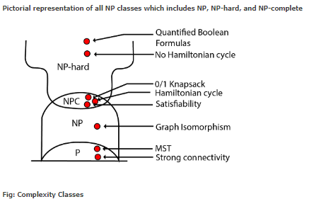

Slide 32
Dynamic programming
Dynamic Programming is the most powerful design technique for solving optimization problems.
Divide & Conquer algorithm partition the problem into disjoint subproblems solve the subproblems recursively and then combine their solution to solve the original problems.
Dynamic Programming is used when the subproblems are not independent, e.g. when they share the same subproblems. In this case, divide and conquer may do more work than necessary, because it solves the same sub problem multiple times.
Dynamic Programming solves each subproblems just once and stores the result in a table so that it can be repeatedly retrieved if needed again.
Dynamic Programming is a Bottom-up approach- we solve all possible small problems and then combine to obtain solutions for bigger problems.
Dynamic Programming is a paradigm of algorithm design in which an optimization problem is solved by a combination of achieving sub-problem solutions and appearing to the "principle of optimality".

Slide 33
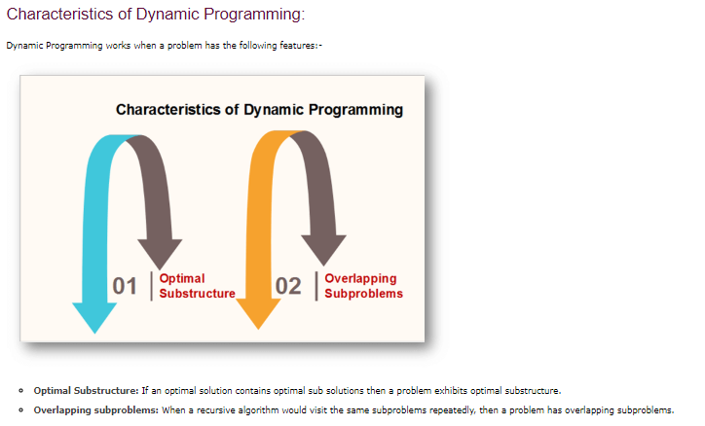

Slide 34
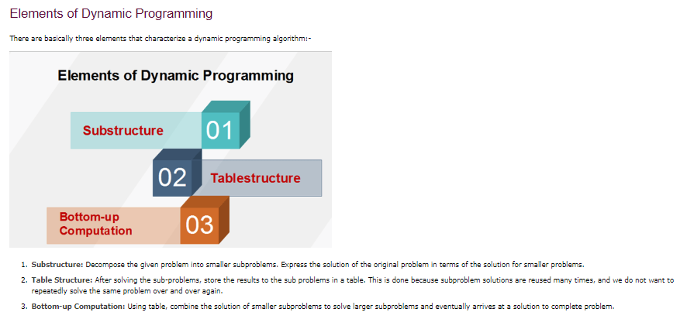

Slide 35
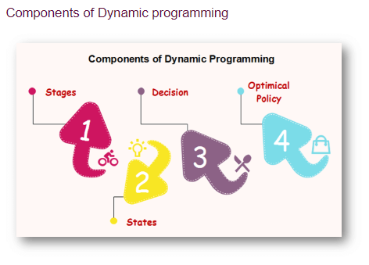

Slide 36
Stages: The problem can be divided into several subproblems, which are called stages. A stage is a small portion of a given problem. For example, in the shortest path problem, they were defined by the structure of the graph.
States: Each stage has several states associated with it.
Decision: At each stage, there can be multiple choices out of which one of the best decisions should be taken.
Optimal policy: It is a rule which determines the decision at each stage; a policy is called an optimal policy if it is globally optimal. This is known as Bellman principle of optimality.
Given the current state, the optimal choices for each of the remaining states does not depend on the previous states or decisions.
There exist a recursive relationship that identify the optimal decisions for stage j, given that stage j+1, has already been solved.
The final stage must be solved by itself.

Slide 37
Development of Dynamic Programming Algorithm
It can be broken into four steps:
Characterize the structure of an optimal solution.
Recursively defined the value of the optimal solution. Like Divide and Conquer, divide the problem into two or more optimal parts recursively. This helps to determine what the solution will look like.
Compute the value of the optimal solution from the bottom up (starting with the smallest subproblems)
Construct the optimal solution for the entire problem form the computed values of smaller subproblems.

Slide 38
Applications of dynamic programming
0/1 knapsack problem
Mathematical optimization problem
All pair Shortest path problem
Reliability design problem
Longest common subsequence (LCS)
Flight control and robotics control
Time-sharing: It schedules the job to maximize CPU usage

Slide 39
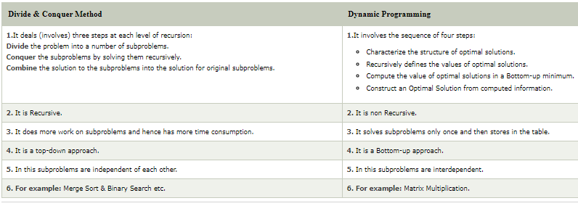

Slide 40
REFERENCE MATERIALS
The design and Analysis of Computer Algorithms by AHO/Hocroft Ullman
Design and analysis of Algorithms by Russell L Shackelford
Introduction to the Design and Analysis of Algorithms by R.C.T Lee, S.S Tseng Chang Y.T Tsai
Judith L GerstingMathematical Structures for computer science 4th edition

